Slide 1
Vectorizing Loops with VPlan – Current State and Next Steps
Ayal Zaks and Gil Rapaport, Vectorization Team, Intel Corporation
October 18th, 2017 US LLVM Developers’ Meeting, San Jose, CA
Notes:
Gil and I have been working on this for a year now; Gil had a presentation earlier this year, and there’s been plenty of progress since then.
If many in the audience have not been to EuroLLVM or attended Gil’s talk, explain the motivation behind VPlan: we’d like to improve LLVM’s vectorization abilities, including handling outerloops as Simon Moll showed earlier today, but it’s hard to do with the existing internal structure in which every decision is recorded in a map. VPlan is a refactoring effort of the existing Loop Vectorizer, striving to retain its existing functionality (that’s hard in itself, as we’ll see – thanks for all the support reporting bugs), providing a modular infrastructure on which to build more powerful vectorizers.

Slide 2
Legal Disclaimer & Optimization Notice
INFORMATION IN THIS DOCUMENT IS PROVIDED “AS IS”. NO LICENSE, EXPRESS OR IMPLIED, BY ESTOPPEL OR OTHERWISE, TO ANY INTELLECTUAL PROPERTY RIGHTS IS GRANTED BY THIS DOCUMENT. INTEL ASSUMES NO LIABILITY WHATSOEVER AND INTEL DISCLAIMS ANY EXPRESS OR IMPLIED WARRANTY, RELATING TO THIS INFORMATION INCLUDING LIABILITY OR WARRANTIES RELATING TO FITNESS FOR A PARTICULAR PURPOSE, MERCHANTABILITY, OR INFRINGEMENT OF ANY PATENT, COPYRIGHT OR OTHER INTELLECTUAL PROPERTY RIGHT.
Software and workloads used in performance tests may have been optimized for performance only on Intel microprocessors. Performance tests, such as SYSmark and MobileMark, are measured using specific computer systems, components, software, operations and functions. Any change to any of those factors may cause the results to vary. You should consult other information and performance tests to assist you in fully evaluating your contemplated purchases, including the performance of that product when combined with other products.
Copyright © 2017, Intel Corporation. All rights reserved. Intel, Pentium, Xeon, Xeon Phi, Core, VTune, Cilk, and the Intel logo are trademarks of Intel Corporation in the U.S. and other countries.
Optimization Notice
Intel’s compilers may or may not optimize to the same degree for non-Intel microprocessors for optimizations that are not unique to Intel microprocessors. These optimizations include SSE2, SSE3, and SSSE3 instruction sets and other optimizations. Intel does not guarantee the availability, functionality, or effectiveness of any optimization on microprocessors not manufactured by Intel. Microprocessor-dependent optimizations in this product are intended for use with Intel microprocessors. Certain optimizations not specific to Intel microarchitecture are reserved for Intel microprocessors. Please refer to the applicable product User and Reference Guides for more information regarding the specific instruction sets covered by this notice. Notice revision #20110804
2

Slide 3
Key Takeaways
Current State: 1st step introducing VPlan to Loop Vectorizer – committed
Records vectorization decisions in VPlan
Drives vector code generation by executing a VPlan
Going Forward: shift vectorization process to be VPlan-based
Refine the model, include masking and break Recipes into VPInstructions
Carry out decisions based on VPlan, in addition to recording them
Make decisions based on VPlan, including legal and cost-based analyses
Notes:
Takeaways are also the agenda of the talk.

Slide 4
Recap: Loop Vectorization Plan
Abandon
1. Legality
1. Legality
Construct
Construct
2. Planning
2. Planning
VPlans.0
VPlans.1
VPlans.N
Best VPlan.N
VPlans.1
VPlans.N
Transform
Transform
Transform
Transform
Select
Uniform
Branches
Interleave
Groups
Cost Model
Uniform
Branches
Cost Model
Interleave
Groups
Cost Model
Cost Model
Cost Model
Cost Model
Cost Model
Select
Execute
Execute
Execute
Execute
Execute
Execute
Execute
Have clear VPlans, straightforward Cost & Execute
Execute
Notes:
There’s been plenty of progress and we have new slides to share, but this one is from Gil’s presentation in EuroLLVM – the vision remained the same
Idea: model vectorization as a planning process, each VPlan is clear and self-contained, leave no sophisticated logic/ad-hoc decisions in Cost and Execute

Slide 5
A. Current state of vplan

Slide 6
1st Step Committed: VPlan Refactors Transform
Predicated Instructions
1. Legality
Sink After
Interleave Groups
2. Cost Model
Should be Scalarized
VPlans
Best VPlan
Construct
Transform
Select
Transform
Sink
Scalar
Operands
3. Planning
Execute
Decisions taken up-front, during execute, or as post-pass
Notes:
We are following a staged approach, starting from the end of the vectorization process and making our way backwards (towards the left).
This is how the Loop Vector works today: Legal and Cost have not changed, both are still making decisions and recording them in various maps. A planning step records them in one or more VPlans, which do not support computing Cost yet, but do support Execution, which is still complex rather than straightforward. Plus the decision to sink scalar operands takes place after generating vectorized code, as originally planned; we’ll see later why VPlan does not record it yet.

Slide 7
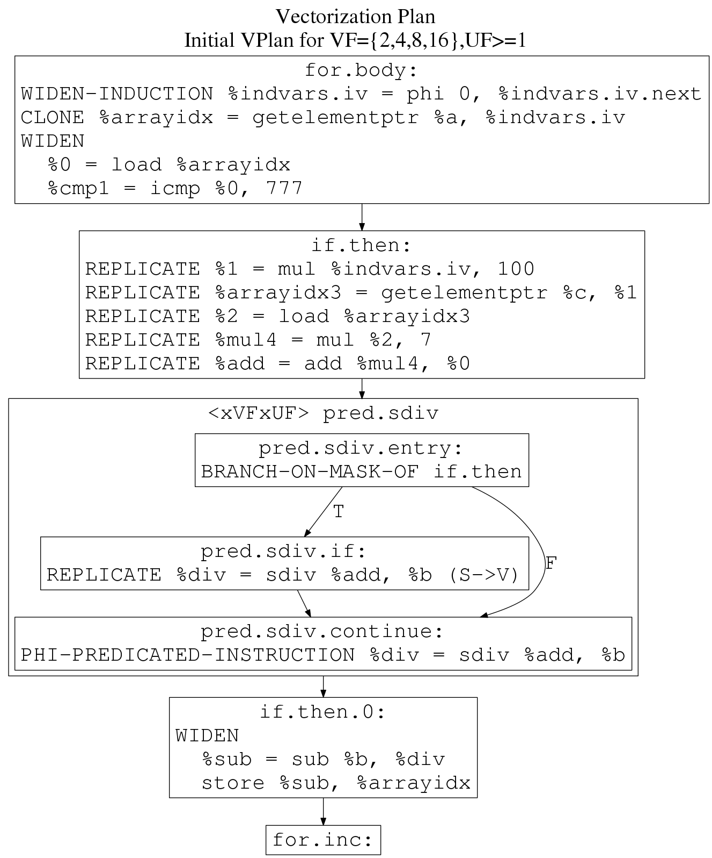
VPlan Model: Current State
void foo(int *a, int b, int *c) {
for (int i = 0; i < 10000; ++i)
if (a[i] > 777)
a[i] = b – (c[100*i] * 7 + a[i]) / b;
}
LLVM-IR Before Vectorizer
for.body:
%indvars.iv = phi i64 [ 0, %entry ], [ %indvars.iv.next, %for.inc ]
%arrayidx = getelementptr inbounds i32, i32* %a, i64 %indvars.iv
%0 = load i32, i32* %arrayidx, align 4
%cmp1 = icmp sgt i32 %0, 777
br i1 %cmp1, label %if.then, label %for.inc
if.then:
%1 = mul nuw nsw i64 %indvars.iv, 100
%arrayidx3 = getelementptr inbounds i32, i32* %c, i64 %1
%2 = load i32, i32* %arrayidx3, align 4
%mul4 = mul nsw i32 %2, 7
%add = add nsw i32 %mul4, %0
%div = sdiv i32 %add, %b
%sub = sub nsw i32 %b, %div
store i32 %sub, i32* %arrayidx, align 4
br label %for.inc
VPlan for
VF={2,4,8}
Notes:
This is what VPlan looks like, when Loop Vectorizer runs on this loop with -debug.
Note the full, explicit control-flow, the divide being guarded by an if-then branch, the whole plan relates to VF=2 or 4 or 8. Other instructions are wrapped in Recipes that record how to vectorize them and where (Widen means extending the types of the operands/results to vectors, Replicate means having VF instances of the original scalar types).
Note that instructions seem to mostly stay in place – there are cases where they must move, as we will see.
Note that the store at the bottom must be masked – but we do not see it here. In fact, we do not see what the vectorized instructions will look like at all. We only see the original IR instructions. The masks will appear only during Execution of the plan, hence its arrow is wide in previous slide.

Slide 8
VPlan Model: Current State
Recipe: models a sequence
of instructions to appear
in the vectorized code.
May refer to Ingredients.
Ingredient: element of the
original scalar loop, such
as an existing instruction.
VPRecipeBase
void execute()= 0
VPBasicBlock *getParent()
VPWidenRecipe
void execute()
VPlan for
VF={2,4,8}
Control-Flow Decisions Explicit, Data-Flow Decisions Implicit
Notes:
Handful of Recipes capture the Loop Vectorizer’s logic, and will generate the vectorized code when asked, but tell you nothing about this code. This is the 1st step, and it was quite large by itself.

Slide 9
B.1. model masking and instructions

Slide 10
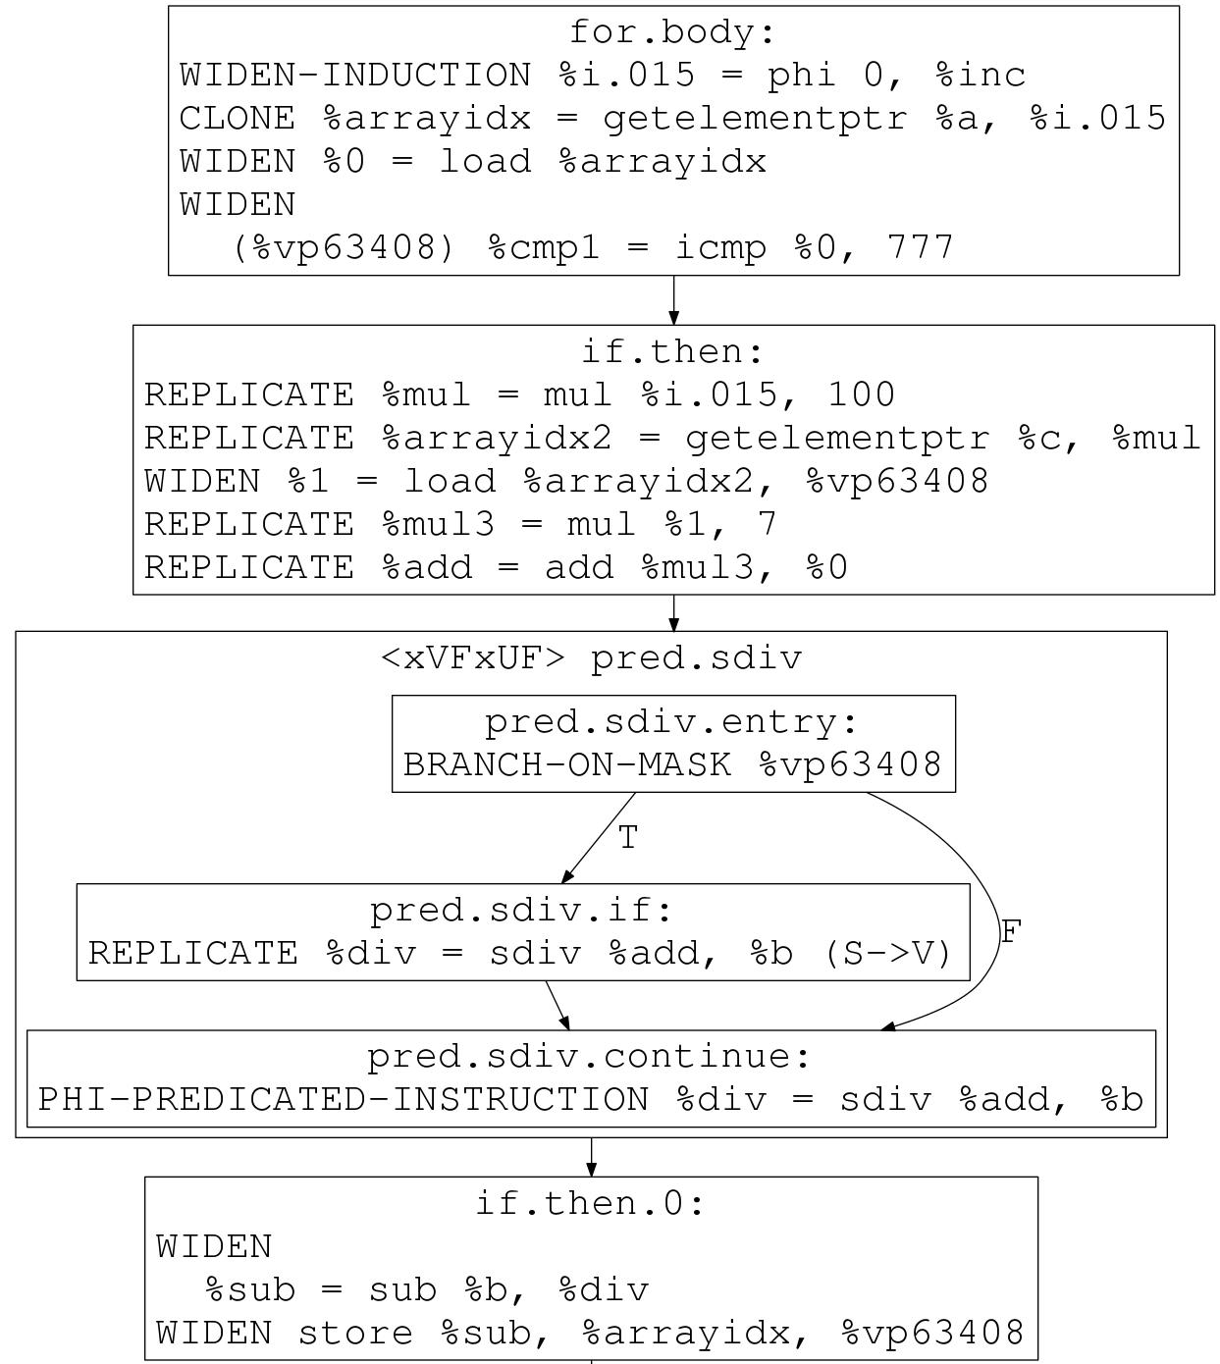
VPlan Model: Next Step
void foo(int *a, int b, int *c) {
for (int i = 0; i < 10000; ++i)
if (a[i] > 777)
a[i] = b – (c[100*i] * 7 + a[i]) / b;
}
VPValue
VPUsers users()
VPRecipeBase
void execute()= 0
VPBasicBlock *getParent()
VPUser
VPValues operands()
VPInterleave
void execute()
Model Masking in VPlan using Def/Use Relations [D38676]
Notes:
This is the next step that’s been posted for review.
Note that the decision to Replicate the load of c[100*i] changed to Widen – that’s a bug, fixed in the patch; we’re trying to maintain existing behavior, and it’s challenging.

Slide 11
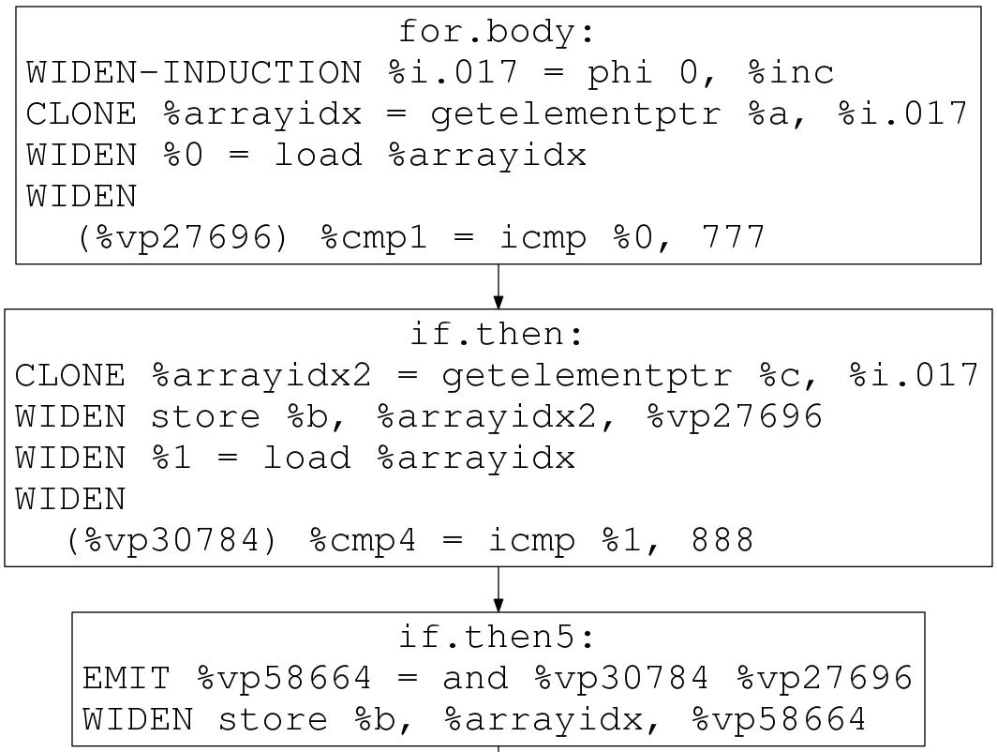
VPlan Model: Next Step (cont’d)
VPlan for VF={2,4,8,16}
void foo(int* a, int b, int* c) {
for (int i = 0; i < 10000; ++i)
if (a[i] > 777) {
c[i] = b;
if (a[i] > 888)
a[i] = b;
}
}
if (a[i] > 888)
VPValue
VPUsers users()
VPRecipeBase
void execute()= 0
VPBasicBlock *getParent()
VPUser
VPValues operands()
VPInstruction
void execute()
uint getOpcode()
VPInterleave
void execute()
VPInstruction: Instruction-level Modeling in VPlan [D38676]
Notes:
A more interesting example involves nested conditions.
Note that the “and” instruction is totally new – it does not have an ingredient. It was taken care of by control-flow branches rather than data-flow instructions. Instructions are generated inside loop body by executing recipe, so this ‘and’ is a recipe, but it also consumes, manipulates and produces masks, modeled by VPUser in this patch. Hence inherits from both.
VPInstruction is the basis for further modeling of vectorizer outcome at instruction granularity. In this next step patch we’re starting from modeling the def/use involved in generating, manipulation (and, or, not instructions) and consuming masks only, again following staged approach.

Slide 12
B.2. From recording decisions to carrying them out
Notes:
What decisions, and why is it important to carry them out gradually using VPlan instead of all at once? We’ll explain using a couple of example.

Slide 13
Taking Decision (1/4): Interleave Groups
void foo(int *a, int n, int *c) {
for (int i = 0; i < n; ++i)
a[i] = 3*c[2*i+1] + c[2*i];
}
IR Before Vectorizer
VPlan for VF=4
IR After Vectorizing for VF=4
foo.body:
…
%0 = load i32, %arrayidx
%mul1 = mul %0, 3
%1 = load i32, %arrayidx3
%add4 = add %mul1, %1
store %add4, %arrayidx5
…
VPInterleaveRecipe:
%1 = load %arrayidx3
%0 = load %arrayidx1
vector.body:
…
%all = load <8 x i32>, %5
%even = shufflevector %all, <0,2,4,6>
%odd = shufflevector %all, <1,3,5,7>
%6 = mul %odd, <3,3,3,3>
%9 = add %6, %even
store %9, %12
…
VPWidenRecipe:
%mul1 = mul %0, 3
%add4 = add %mul1, %1
store %add4, %arrayidx5
Ingredients
VPlan Execution
Effectively hoists load %1 to join load %0
Notes:
In practice, Loop Vectorizer throws the later load away, keeping the early one along with grouping information.

Slide 14
Taking Decision (2/4): Unravel 1st Order Recurrence
void sink_after(short *a, int *b, int n) {
for (int i = 0; i < n; ++i)
b[i] = (a[i] * a[i+1]);
}
IR Before Vectorizer
IR After Vectorizer
foo.body:
%iv = phi i64 [ 0, %entry ], [ %iv.next, %for.body ]
%0 = phi i16 [ %.pre, %entry ], [ %1, %for.body ]
%conv = sext i16 %0 to i32
%iv.next = add nuw nsw i64 %iv, 1
%arrayidx2 = getelementptr i16, i16* %a, i64 %iv.next
%1 = load i16, i16* %arrayidx2
%conv3 = sext i16 %1 to i32
%mul = mul nsw i32 %conv3, %conv
%arrayidx5 = getelementptr i32, i32* %b, i64 %iv
store i32 %mul, i32* %arrayidx5
%exitcond = icmp eq i64 %indvars.iv.next, %n
br i1 %exitcond, label %for.end, label %for.body
vector.body
%iv = phi i64 [ 0, %vec.ph ], [ %iv.next, %vec.body ]
%recur = phi <4 x i16> [ %recur.init, %vec.ph ],
[ %wide.load, %vec.body ]
…
%3 = getelementptr inbounds i16, i16* %a, i64 %2
%wide.load = load <4 x i16>, <4 x i16>* %5, align 2
%6 = shufflevector <4 x i16> %recur,
<4 x i16> %wide.load,
<4 x i32> <3, 4, 5, 6>
%7 = sext <4 x i16> %6 to <4 x i32>
%8 = sext <4 x i16> %wide.load to <4 x i32>
%9 = mul nsw <4 x i32> %8, %7
…
Phase-ordering: first sink cast after load, then hoist interleave load [PR34743]
Notes:
Another decision, which also emphasizes the importance of being able to compose decisions

Slide 15
Taking Decision (3/4): Predication
Must convert divergent branches using masking
Much more challenging for outer-loop vectorization
Earlier today: VPlan + RV: A Proposal by Simon Moll and Sebastian Hack
Last year’s Extending LoopVectorizer: by Hideki Saito:
julb = hmin(jlb(i)); juub = hmax(jub(i)); cont1 = T; for (j = julb; j < juub; ++j) { if (jlb(i) <= j && j < jub(i) && cont1) { cont2 = cond(i, j); while (hor(cont2)) { if (cont2) { … cont2 = cond(i, j); } } if (…) cont1 = F; if (!hor(cont1)) break; } }
// vectorize here for (i = ilb; i < iub; ++i) { … for (j = jlb(i); j < jub(i); ++j) { while (cond(i, j)) { … } if (…) break; } }
Take Predication Decisions by Transforming One VPlan to Another
Notes:
How do we carry out this decision, which transforms control-flow and introduces masking instructions such as ‘and’, ’or’, ’not’ and more, along with the previous decisions?

Slide 16
Taking Decision (4/4): SinkScalarOperands
Requires Fine-grain Modeling of Def/Use at instruction-level
Notes:
Modeling these instructions as VPInstructions allows to traverse their def/use relations, and facilitates carrying out sinkScalarOperands in VPlan.

Slide 17
B.3. From CARRYING OUt decisions to making them

Slide 18
Use VPlan to also Make Vectorization Decisions
Instead of first making the decisions, and then using VPlan to carry them out
Run cost-based analyses on VPlan
Based on cost estimates computed by VPlan
Based on VPInstruction model
Apply desired decisions by transforming VPlan, potentially versioning it
Based on “what-if” versioning support

Slide 19
Expand VPlan’s Scope Beyond Vector Loop Body
VPlans
Loop
Vectorization
Another dimension to expand VPlan’s coverage
Execute
Notes:
Various instructions may be generated in the middle and other blocks, taking care of reduction, external users; ideally they are all part of VPlan. Also tentative peeling first iterations into another loop to optimize alignment of vector loops.

Slide 20
Taking Decision (1/4): Interleave Groups – revisit
void foo(int *a, int n, int *c) {
for (int i = 0; i < n; ++i)
a[i] = 3*c[2*i+1] + c[2*i];
}
IR Before Vectorizer
VPlan for VF=4
IR After Vectorizing for VF=4
foo.body:
…
%0 = load i32, %arrayidx
%mul1 = mul %0, 3
%1 = load i32, %arrayidx3
%add4 = add %mul1, %1
store %add4, %arrayidx5
…
VPInterleaveRecipe:
%1 = load %arrayidx3
%0 = load %arrayidx1
vector.body:
…
%all = load <8 x i32>, %5
%even = shufflevector %all, <0,2,4,6>
%odd = shufflevector %all, <1,3,5,7>
%6 = mul %odd, <3,3,3,3>
%9 = add %6, %even
store %9, %12
…
VPWidenRecipe:
%mul1 = mul %0, 3
%add4 = add %mul1, %1
store %add4, %arrayidx5
Ingredients
VPlan Execution
Combining two load %0, %1 into one load %all – looks familiar?

Slide 21
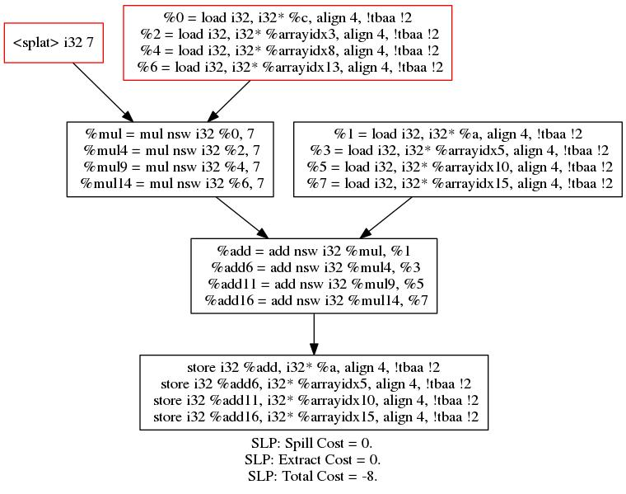
A Model for Vectorized Instructions?
void foo(int * restrict a, int b, int *c) {
a[0] = c[0] * 7 + a[0];
a[1] = c[2] * 7 + a[1];
a[2] = c[1] * 7 + a[2];
a[3] = c[3] * 7 + a[3];
}
opt -slp-vectorizer –view-slp-tree -…
Notes:
Before finishing, one last thought – perhaps we already have a vpinstruction-like model in llvm?
What kind of graph is this?

Slide 22
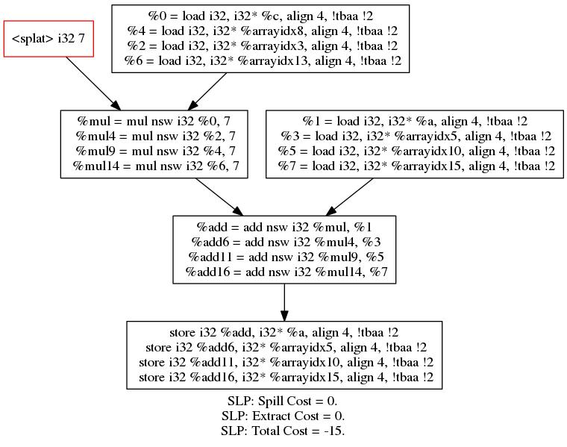
A Model for Vectorized Instructions?
*Shuffle jumbled load [D31610] <c[0],c[1],c[2],c[3]> ➔ <0,2,1,3>
void foo(int * restrict a, int b, int *c) {
a[0] = c[0] * 7 + a[0];
a[1] = c[2] * 7 + a[1];
a[2] = c[1] * 7 + a[2];
a[3] = c[3] * 7 + a[3];
}
Def/Use Model for New & Ingredient-based Instructions & Dependences
opt -slp-vectorizer* -slp-view-tree -…
Notes:
Shahid Asghar-Ahmad shows how to do this better, improve cost from -8 to -15, by using a “new” shuffle instruction, similar to our ‘and’ vpinstruction. But SLP model records only the (purple) nodes of the def/use graph, relying on the original (green) def/use edges of the underlying IR ingredients.

Slide 23
Key Takeaways
Current State: 1st step introducing VPlan to Loop Vectorizer – committed
Records vectorization decisions in VPlan
Drives vector code generation by executing a VPlan
Going Forward: shift vectorization process to be VPlan-based
Refine the model, include masking and break Recipes into VPInstructions
Carry out decisions based on VPlan, in addition to recording them
Make decisions based on VPlan, including legal and cost-based analyses
Notes:
Lots of work still remains to do, it’s all taking place in trunk, plenty of room for additional contributors

